Slide 1


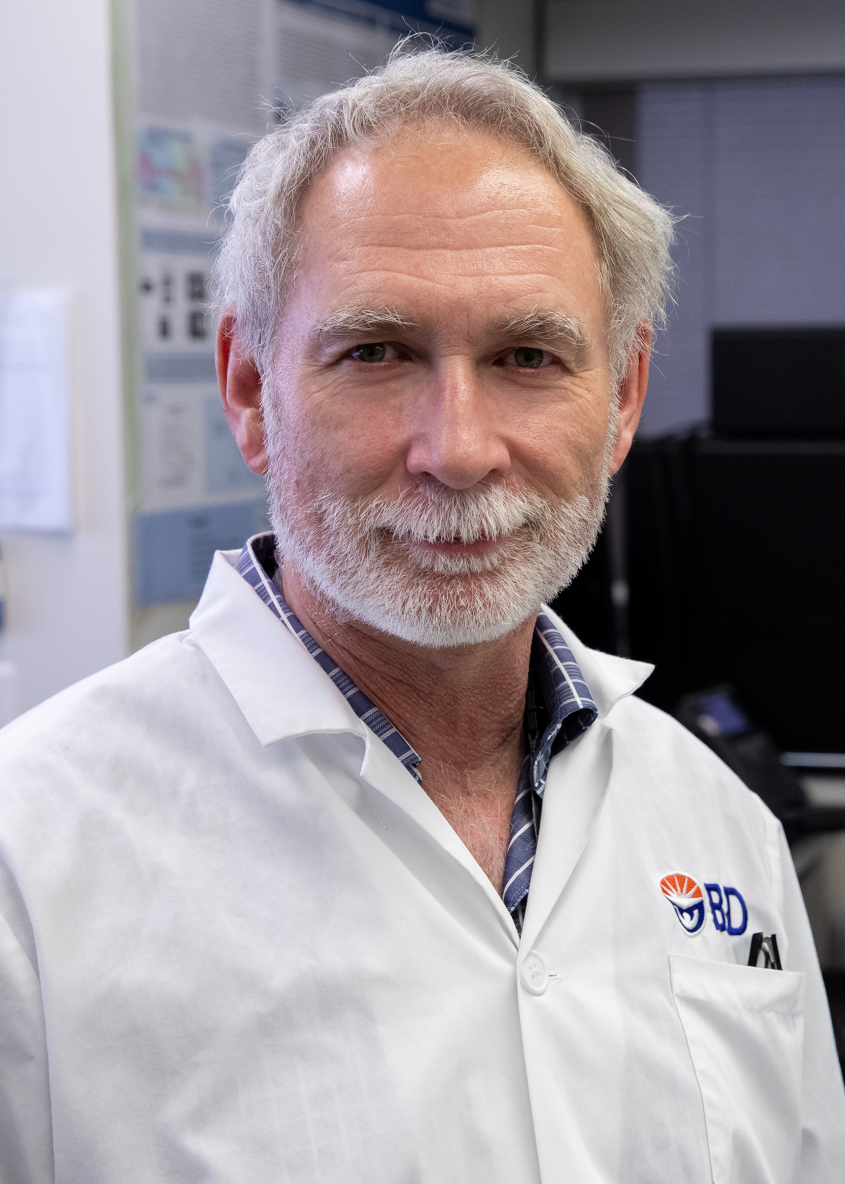
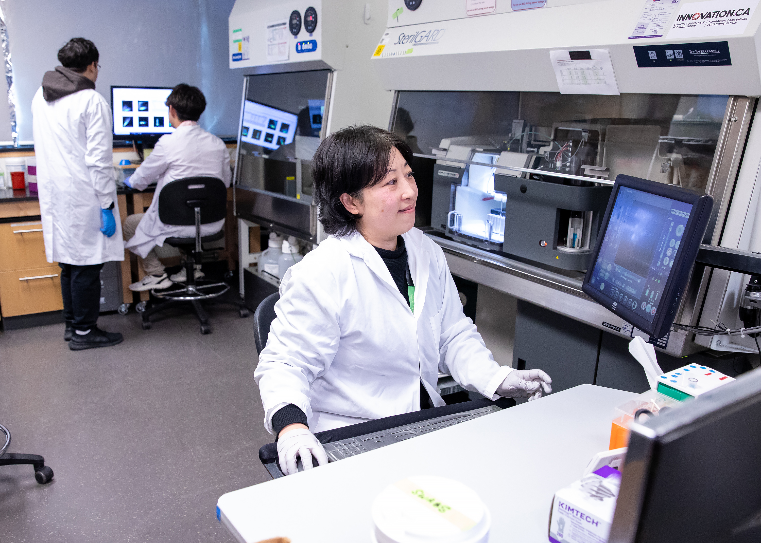
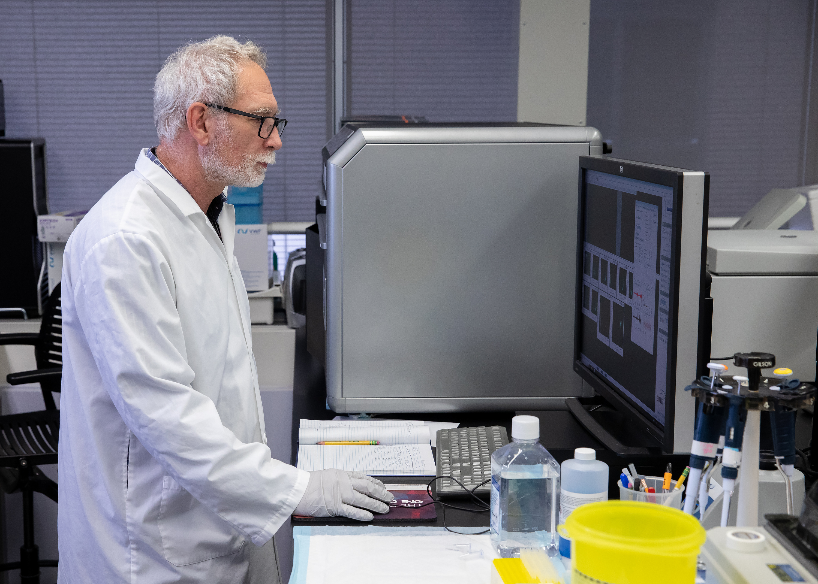
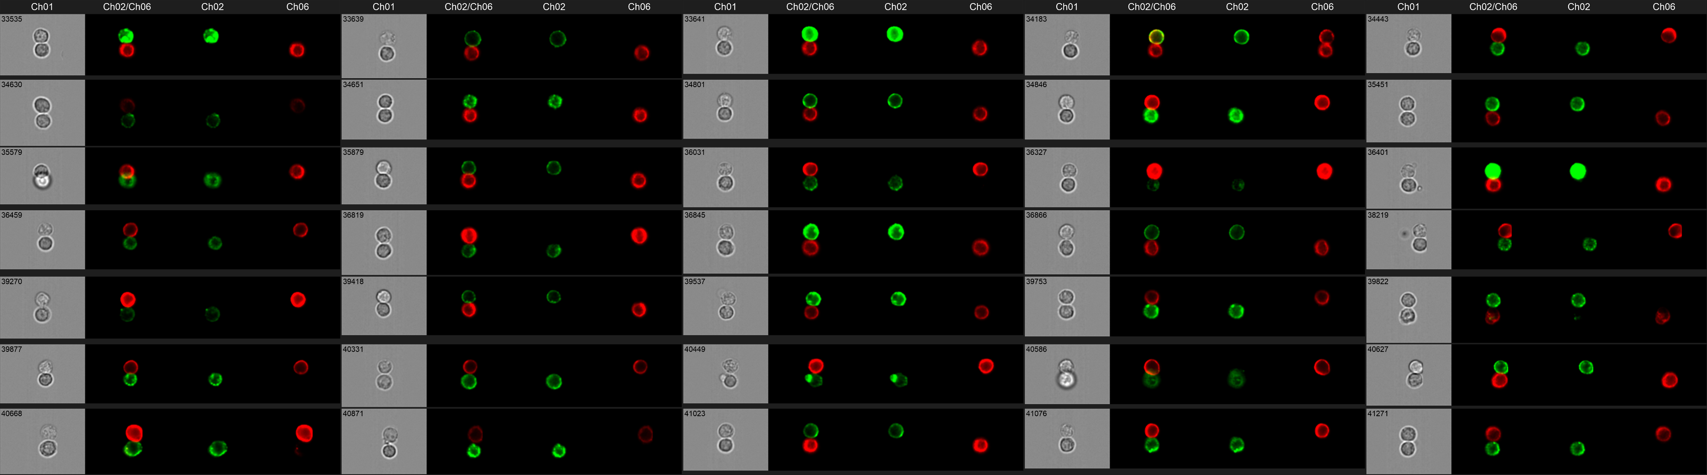
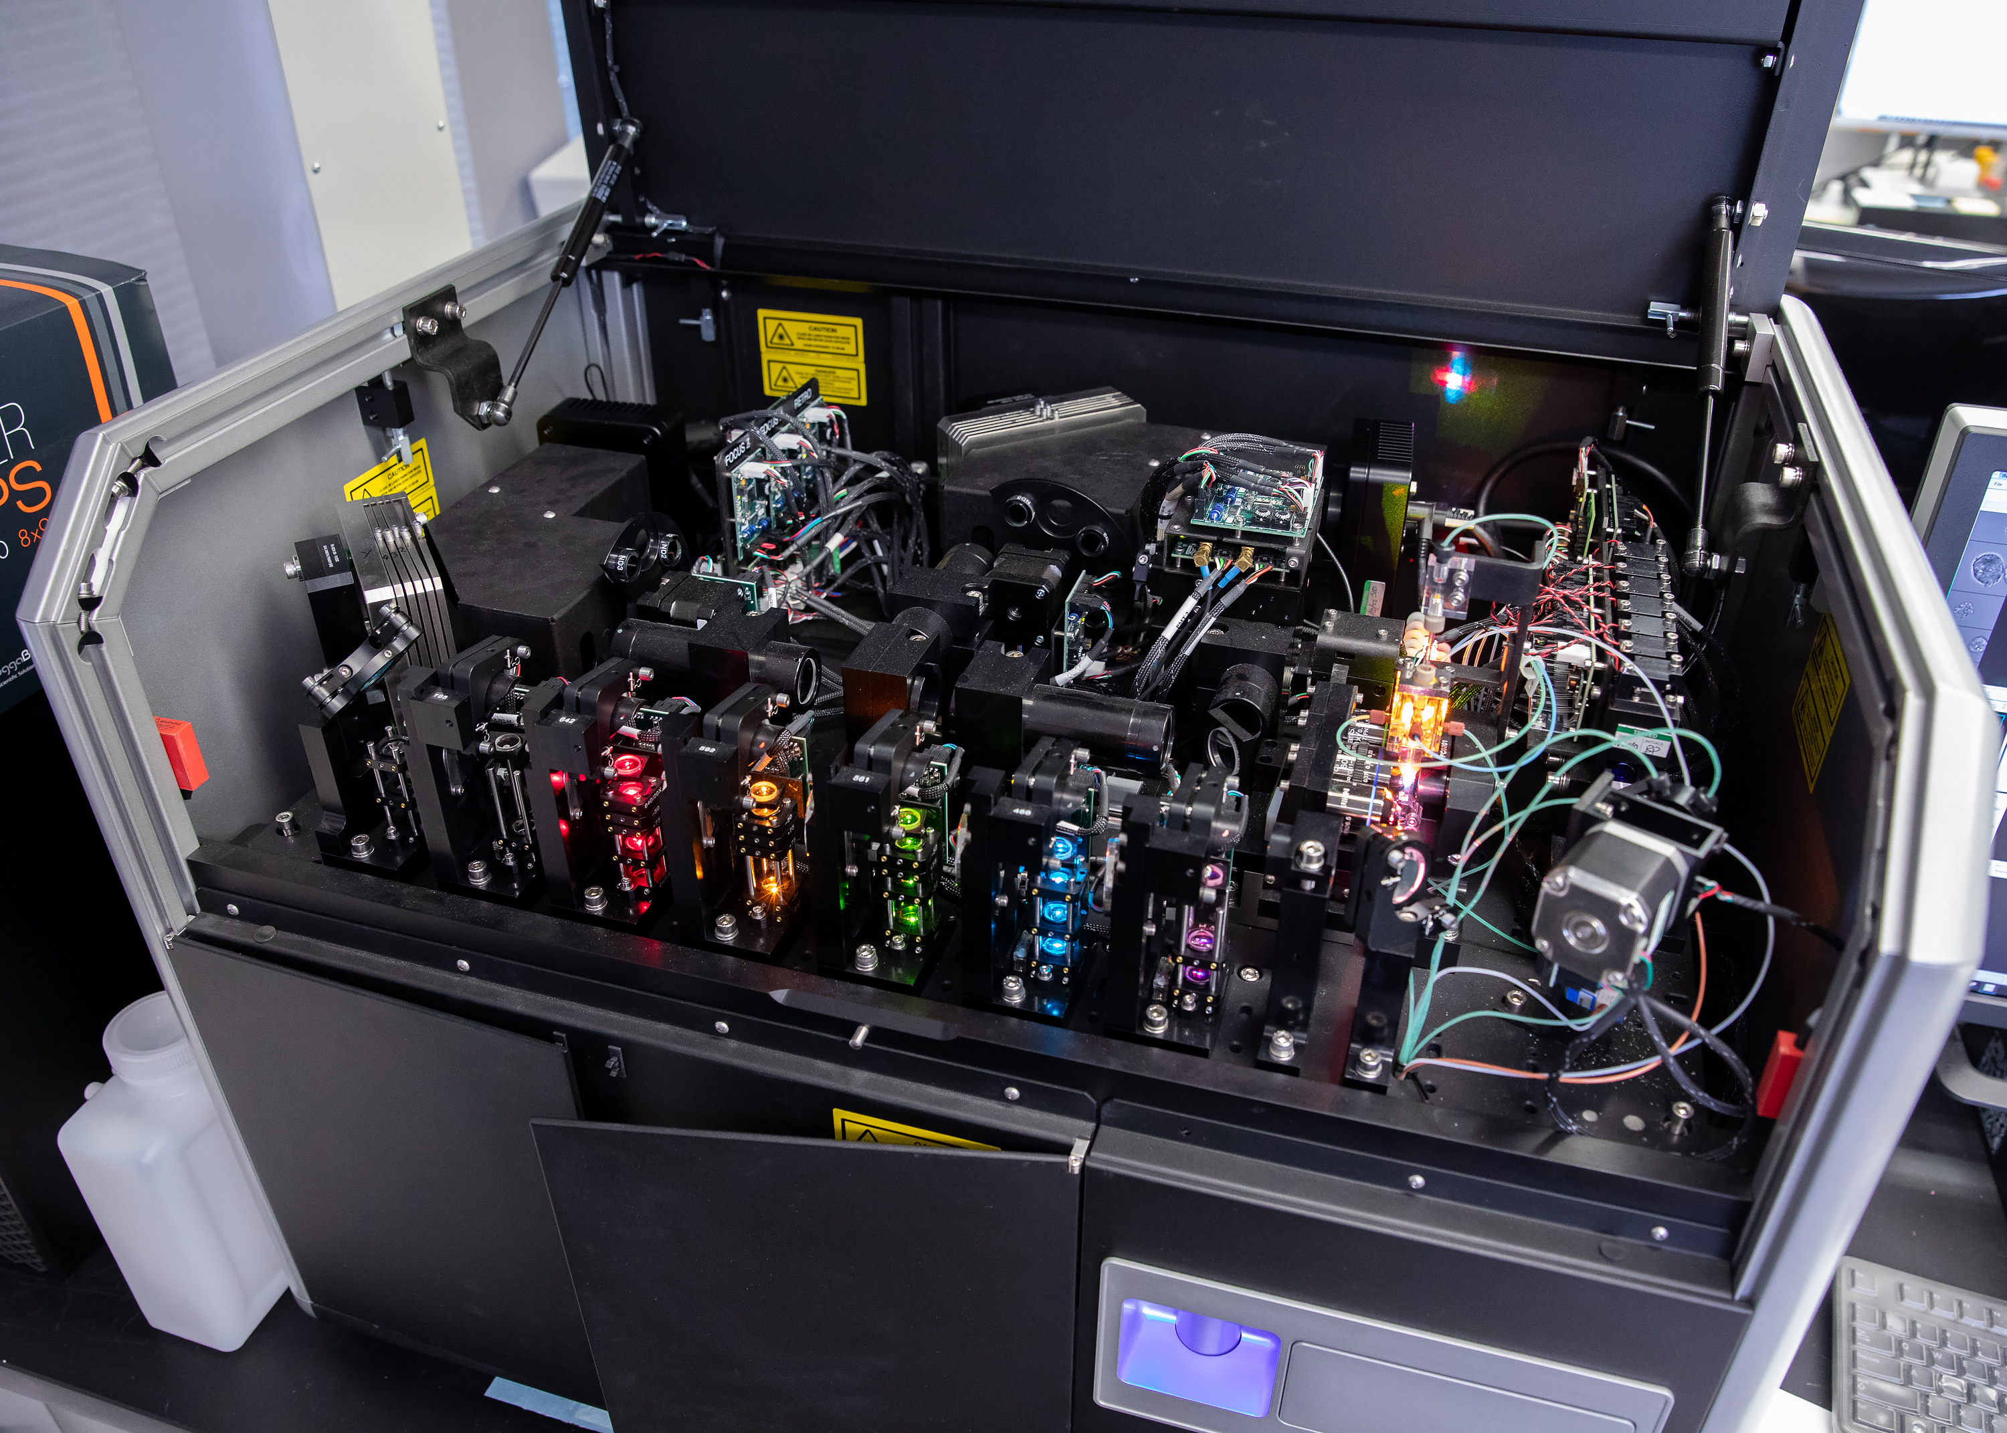
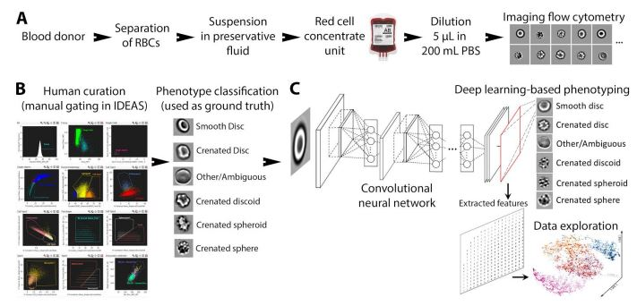
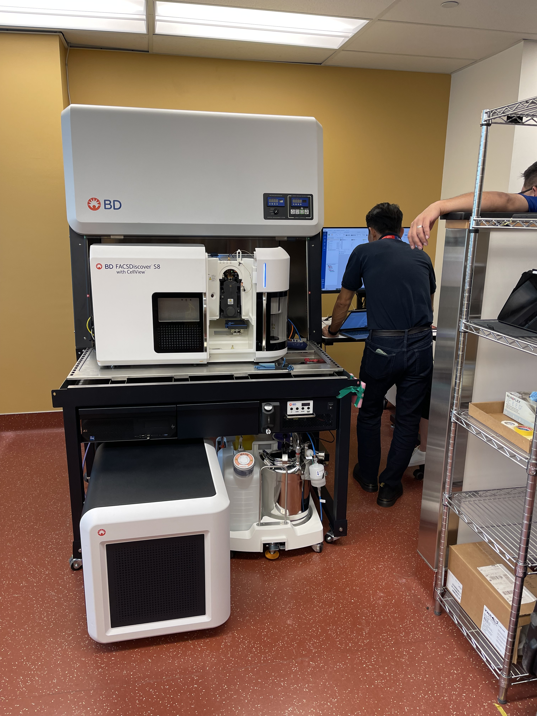
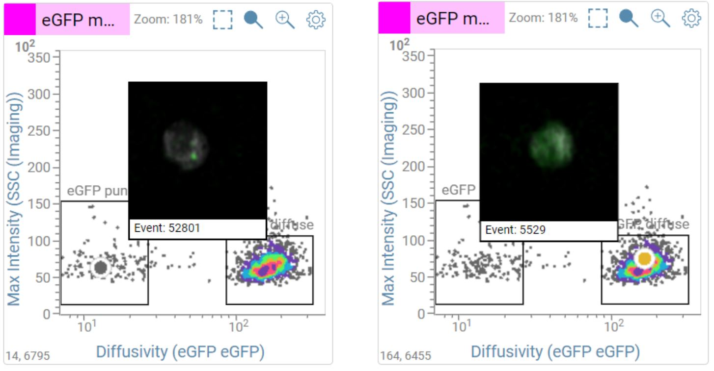
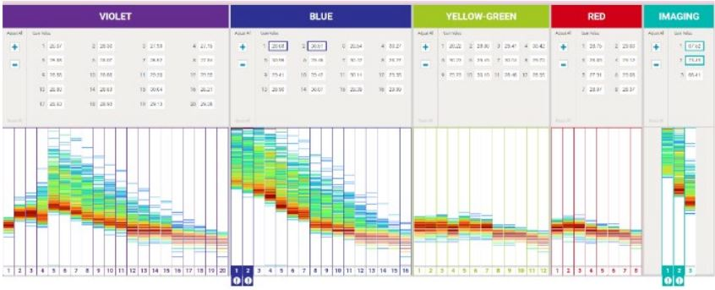
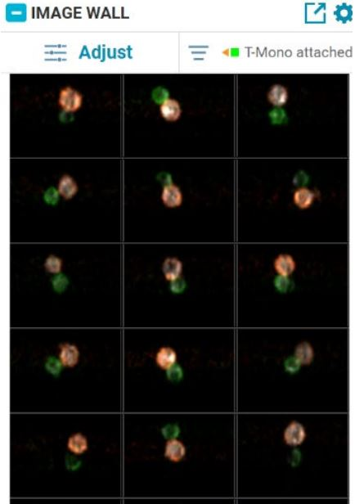
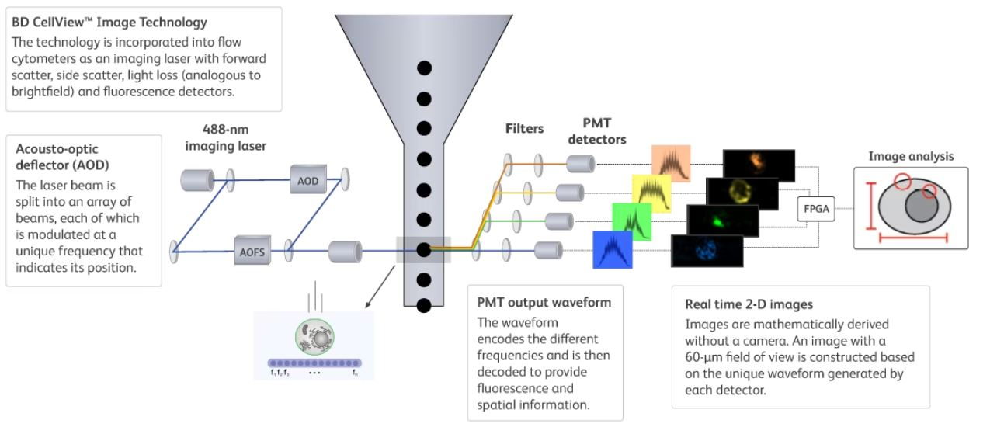
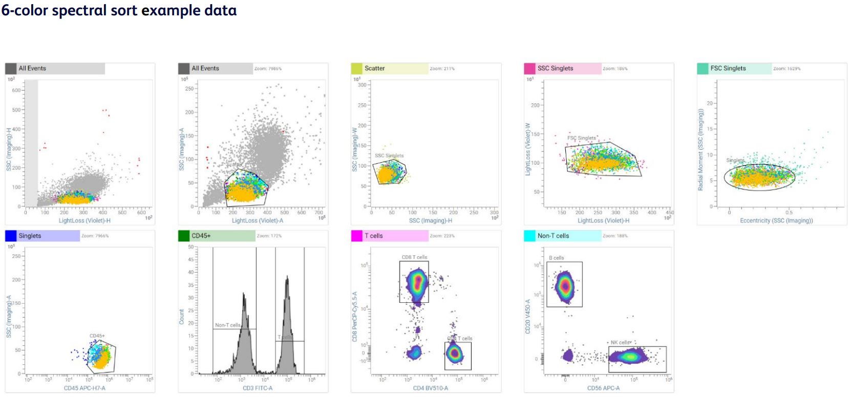
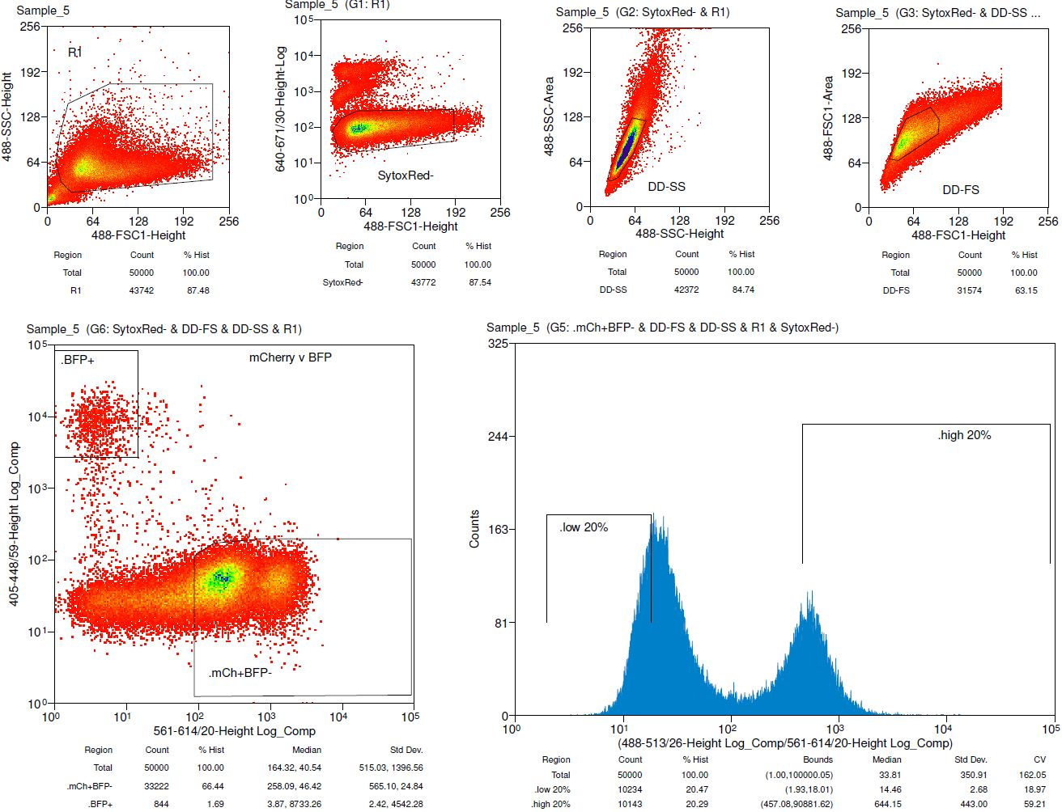
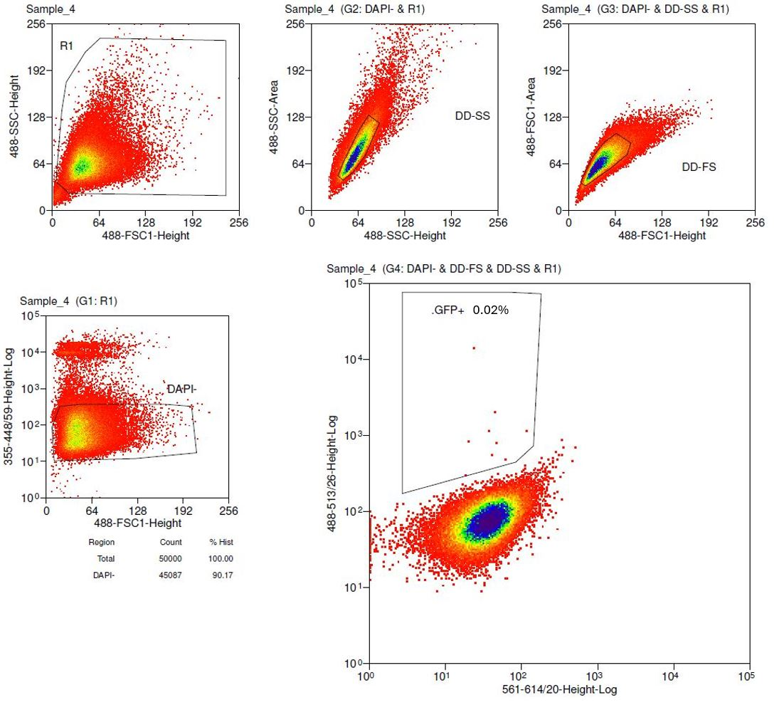
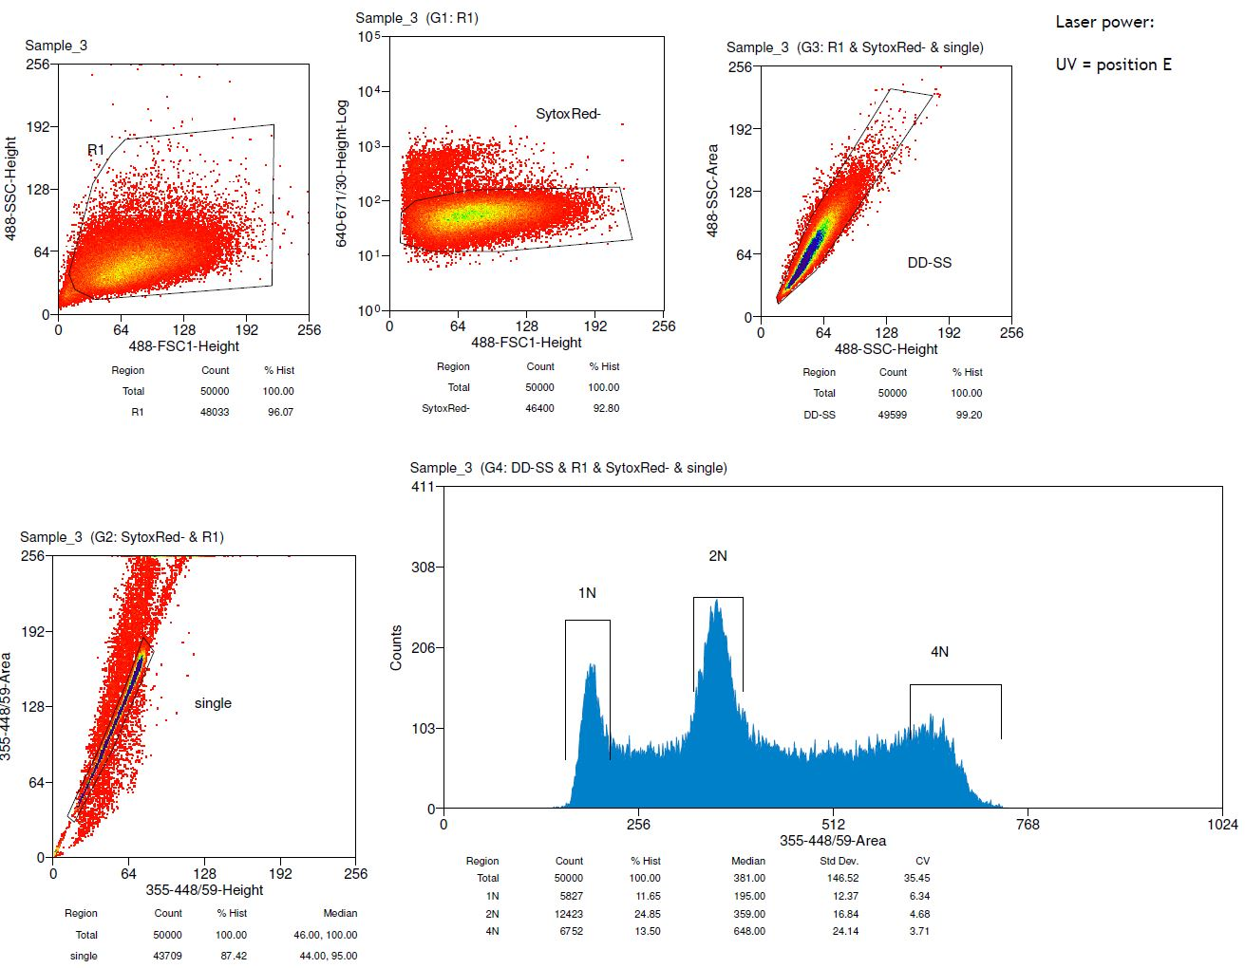
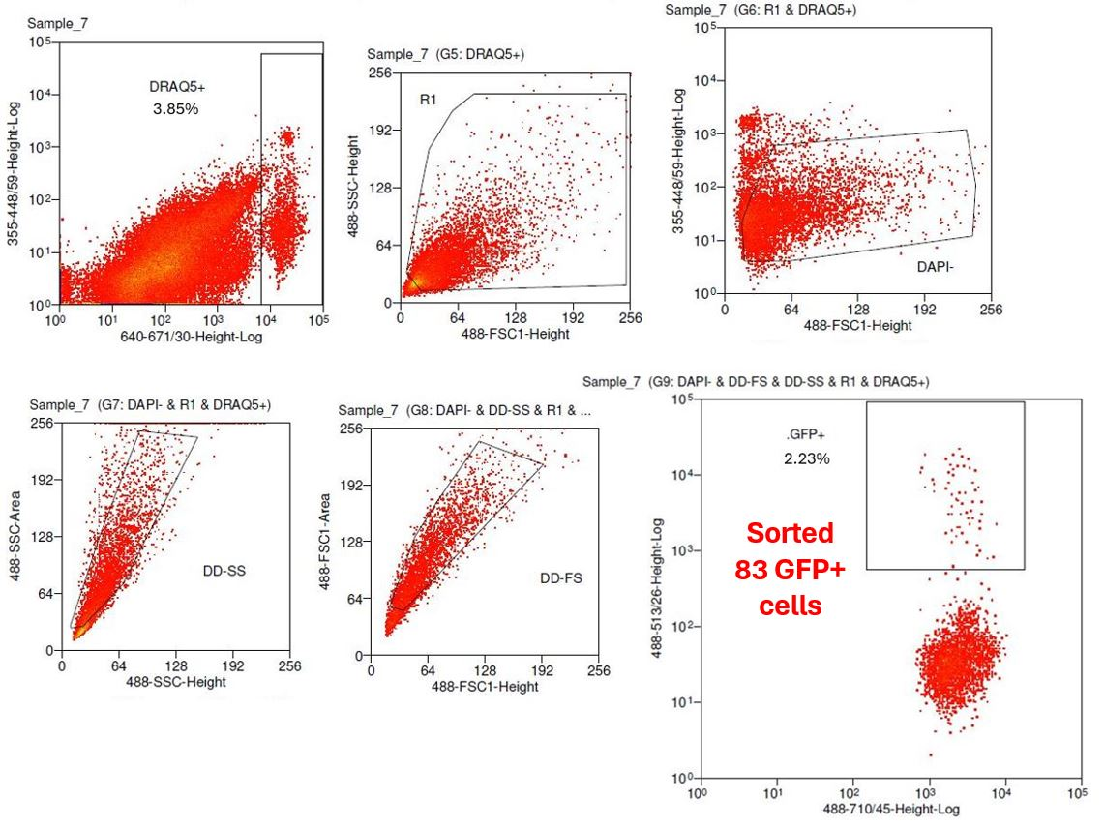
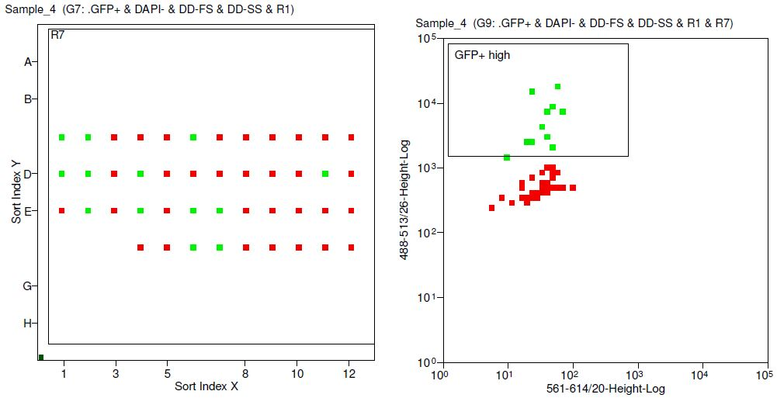
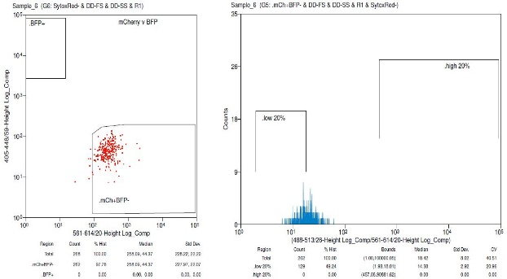
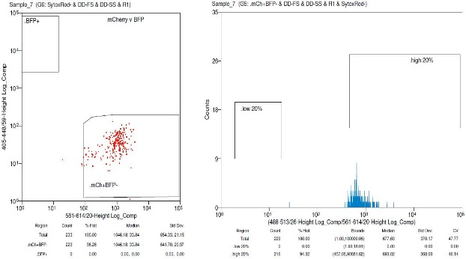
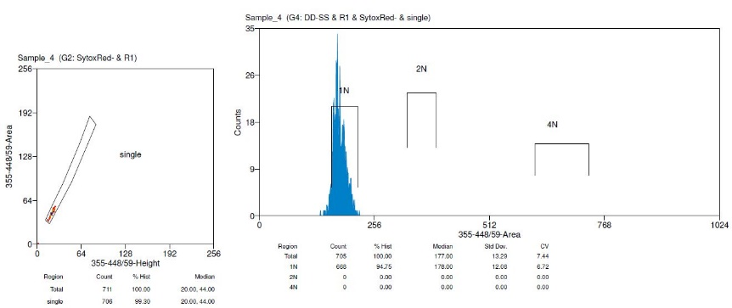
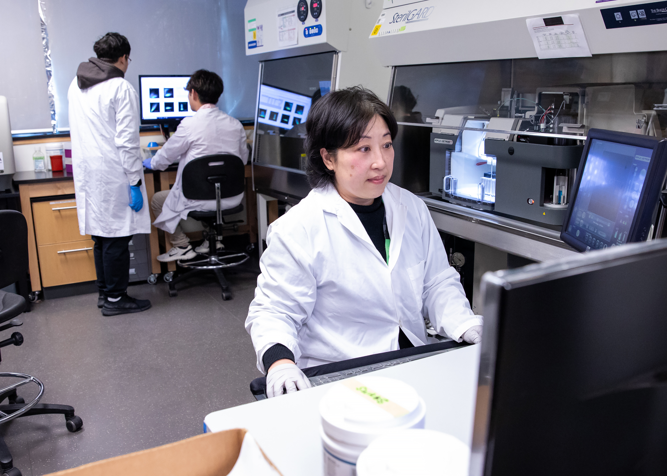



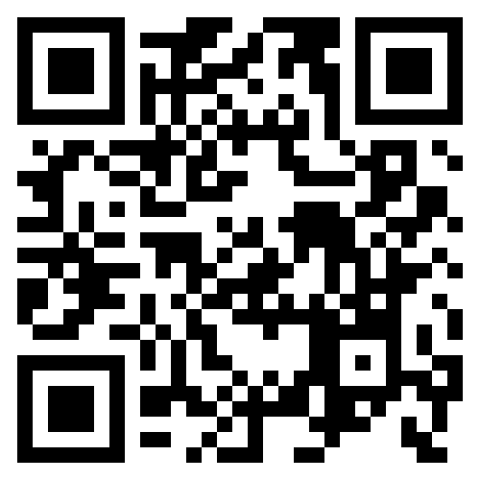


NBCC Flow Cytometry
We are a shared resource facility with many years of expertise providing a variety of flow cytometry analyzers and cell sorters, specializing in Imaging Flow Cytometry
Amnis ImageStream
Machine learning –classifiers to identify T and B cells in contact
Immune Synapse Discovery
Brightfield
Composite T &B
B cell
T cell
Gallery of doublets of interest
Image Analysis combined with the statistical power
and hierarchal gating
of flow cytometry
Powered by Machine Learning
Michael Parsons
parsons@lunenfeld.ca
MSH 980
Annie Bang
bang@lunenfeld.ca
25 Orde L4-420-421
Deep Learning to classify RBC shapes
BD FACS Discover S8 Cell Sorter with CellView Imaging
How we help
Full suite analyzers/cell sorters
Full service and self-directed flow cytometry analysis and cell sorting available
Imaging flow cytometry with machine learning powered analysis
State of the art image enabled/spectral cell sorting
High level consultation, experimental design, troubleshooting, and data analysis
Comprehensive training from in depth theory to hands on instrument training
Cell Sorting applications include:
Primary tissue sort for RNA/DNA analysis
Multi-color sort for bulk culture
Indexed single cell sort into 96-well plate
Cell cycle phase sort
GFP+ high cells in wells
C1 C2 C6
D1 D2 D4 D11
E2 E4 E6 E7
F6 F7
Flow Cytometry Analyzers (FCM)
Self Directed Flow Cytometry Analysis & Cell Sorting
BD Fortessa X-20 (HTS) 5 lasers-18 color detectors/FS/SS
BD Fortessa (HTS) 4 lasers-14 color detectors/FS/SS
Coulter Gallios 4 lasers-10 color detectors/FS/SS
ThermoFisher Attune NxT (HTS) 4 lasers-16 color detectors/FS/SS
Amnis ImageStream 5 lasers-10 colour detectors/BF/DF
We have coached many researchers to perform their own experiments using:
Flow cytometry analyzers
Sony MA900 cell sorter
Data analysis software (FlowJo, Kaluza, IDEAS, ModFit)
Cell Sorters (FACS)
Coulter MoFlo ASTRIOS EQ 5 lasers-18 color detectors/FS/SS
Sony MA900 4 lasers-12 color detectors/FS/BS
BD FACS Discover S8 5 lasers-Full Spectrum (78 color detectors) & CellView Imaging (3 color detectors/LL/FS/SS)
Find us online:
nbcc.lunenfeld.ca

